Slide 1
Lecture 1: Chapter 1 Sec. 3 DATA REPRESENTATION AND COMPUTER ARITHMETIC

Slide 2
A Computer System
C/C++/JAVA
o.s., compiler, assembler, assembly language
hardware
understands whether a switch is on or off.
USERS
SYSTEM SOFTWARE
HARDWARE

Slide 3
A computer system consists of:
Users – write programs in higher level languages
System software
Operating system O.S is :
An interface between users and hardware
A resource manager (CPU, memory, files, etc)
Compiler:
Translates high level language (C, C++, Java) into an assembly language
An assembly language is a mnemonic version of machine language.
ex. X86 intel assembler
Assembler:
Translates an assembly language into a machine language
Hardware only understand whether a switch is on or off.

Slide 4
Language Translation
Higher lower
level level
language language
Assembly machine
Language language
com
compiler
com
Assembler

Slide 5
Number systems
use Decimal
use Hexadecimal
stored in BINARY
USERS
CPU
MEMORY

Slide 6
Data types in an assembly language
Characters:
‘0’, ... , ‘9’
(30)₁₆, (31)₁₆, … , (39)₁₆
Integers
Floats
Units of information
1 bit represents whether a switch on or off.
1 byte = 8 bits
1 byte =
ASCII →7 bits = 2⁷ = 128
(Study & Understand)
‘A’ = (41)₁₆, ‘B’ = (42)₁₆, …, ‘Z’ = (5A)₁₆
‘a’ = (61)₁₆, ‘b’ = (62)₁₆, …, ‘z’ = (7A)₁₆
EBCDIC → 8 bits = 2⁸ = 256
1 word = 2 bytes

Slide 7
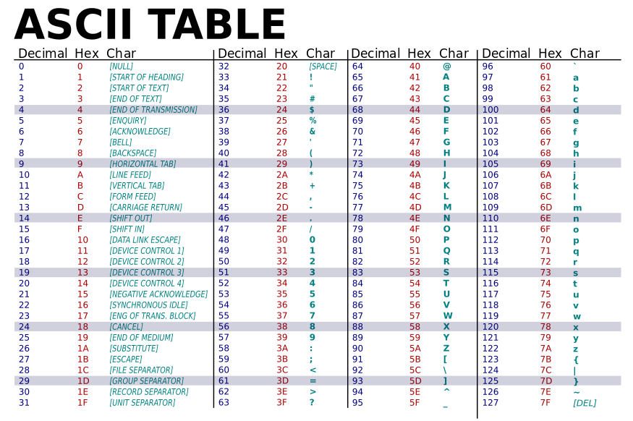

Slide 8
Example 1
Write your name in ASC II.

Slide 9
Number systems
Users → decimal
CPU → hexadecimal
Hardware → binary
A number N in base b can be represented as a polynomial of the form:
(N)_{b} = a_{i}b^{i}, where a_{i} ε [0, …, b-1]
Case 1: b = 2 binary , a_{i} ε [0,1]
ex. (101.11)₂ = 1*2² + 0*2¹ + 1*2⁰ +1*2⁻¹ + 1*2⁻²
Case 2: b = 10 decimal, a_{i} ε [0,…., 9]
ex. (310)₁₀ = 3*10² + 1*10¹ + 0*10⁰
Case 3: b = 16 hexadecimal, a_{i} ε [0, …, 9, A, B, C, D, E, F]
ex. (A2F)₁₆ = A*16² + 2*16¹ + F * 16⁰

Slide 10
Number conversion
Decimal to binary
ex. 123
123/2, 61/2, 30/2, 15/2, 7/2, 3/2, ½ = 1111011
Decimal to hexadecimal
ex. 53241 = (CFF9)₁₆
53241/16 = 3327 (9/16) → 9
3327 / 16 = 207 (15/16) → F
207 / 16 = 12 (15/16) → F
12 / 16 = 0 (12/16) → C
Binary to decimal
ex. (1010111)₂ = 1*2⁶ + 0*2⁵ + 1*2⁴ + 0*2³ + 1*2² + 1*2¹ + 0*2⁰ = (87)₁₀
Hexadecimal to decimal
ex. (1AC)₁₆ = 1*16² + A*16¹ + C*16⁰ = (428)₁₀

Slide 11
DEC HEX BINARY
0 0 0000
1 1 0001
2 2 0010
3 3 0011
4 4 0100
5 5 0101
6 6 0110
7 7 0111
8 8 1000
9 9 1001
10 A 1010
11 B 1011
12 C 1100
13 D 1101
14 E 1110
15 F 1111
BCD (Binary Coded Decimal)
1 9 4 2
0001 1001 0100 0010

